Slide 1
Passing Pointers in Structures, Dynamic Structure Allocations & Unions
Chapter 9
(Pt 2)
ELEMENTS OF PROGRAMMING
CSC 1100

Slide 2
Objectives
CSC 1100 – Wk11
In this chapter, you will learn about:
Passing pointers in Structure
Dynamic Structure Allocation
Unions
Common Programming Errors
A First Book of C++ 4th Edition

Slide 3
Passing a Pointer
CSC 1100 – Wk11
Using a pointer requires modifications to Program 16.4:
Call to calcNet(): calcNet(&emp);
calcNet() function definition/header:
double calcNet(Employee *pt)
Example:
Declares pt as a pointer to structure of type Employee
pt receives starting address of structure whenever calcNet() is called
calcNet() uses pt to access members of structure
A First Book of C++ 4th Edition

Slide 4
Passing a Pointer (cont'd.)
CSC 1100 – Wk11
Example:
(*pt).idNum refers to idNum member
(*pt).payRate refers to payRate member
(*pt).hours refers to hours member
These relationships are illustrated in Figure 16.3
Parentheses around the expression *pt in Figure 16.3 are necessary to initially access “the structure whose address is in pt”
A First Book of C++ 4th Edition

Slide 5
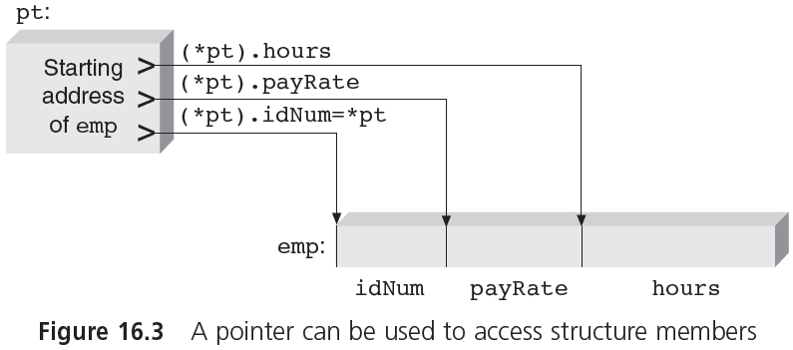
Passing a Pointer (cont'd.)
CSC 1100 – Wk11
A First Book of C++ 4th Edition

Slide 6
Passing a Pointer (cont'd.)
CSC 1100 – Wk11
Starting address of emp is also address of first member of the structure (Figure 16.3)
Special notation commonly used
Expression (*pointer).member can always be replaced with notation pointer->member
The following expressions are equivalent:
(*pt).idNum can be replaced by pt->idNum
(*pt).payRate can be replaced by pt->payRate
(*pt).hours can be replaced by pt->hours
(*pt). IS EQUIVALENT to pt->
A First Book of C++ 4th Edition

Slide 7
Passing a Pointer (cont'd.)
CSC 1100 – Wk11
Program 16.5 illustrates passing structure’s address
Uses a pointer with -> notation to reference structure directly
When calcNet() is called with statement
netPay = calcNet(&emp);// function call
emp’s starting address is passed to the function
Using this address as starting point, individual members of structure are accessed by including their names with pointer
accessing the hours member of the structure emp :
emp -> hours
A First Book of C++ 4th Edition

Slide 8
Passing a Pointer (cont'd.)
CSC 1100 – Wk11
To increment or decrement a pointer, we use the increment or decrement operators
Expression ++pt->hours; adds one to hours member of emp structure
-> operator has higher priority than increment operator, therefore, hours member is accessed first, then increment is applied
Expression (++pt)->hours; increments address before hours member is accessed
Expression (pt++)->hours; increments address after hours member is accessed (or access member first, then increment address)
A First Book of C++ 4th Edition

Slide 9
Passing a Pointer (cont'd.)
CSC 1100 – Wk11
Example (Fig 16.4): Array of three structures of type employee with address of emp[1] stored in the pointer variable pt
Expression (++pt) changes address in pt to starting address of emp[2]
Expression (--pt) changes address in pt to starting address of emp[0]
A First Book of C++ 4th Edition

Slide 10
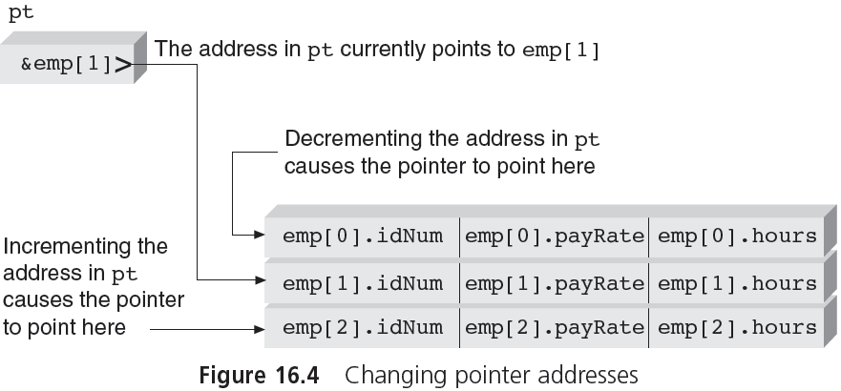
Passing a Pointer (cont'd.)
CSC 1100 – Wk11
(--pt)
(++pt)
A First Book of C++ 4th Edition

Slide 11
CSC 1100 – Wk11
//passing a pointer
#include <iostream>
#include <iomanip>
using namespace std;
struct Employee // declare a global type
{
int idNum;
double payRate;
double hours;
};
double calcNet(Employee *); //function prototype
int main()
{
Employee emp = {6782, 8.93, 40.5};
double netPay;
Declare emp of type Employee
A First Book of C++ 4th Edition

Slide 12
CSC 1100 – Wk11
//passing a pointer
//pass an address
netPay = calcNet(&emp);//assign return value to netPay
// set output formats
cout << setw(10)
<< setiosflags(ios::fixed)
<< setiosflags(ios::showpoint)
<< setprecision(2);
cout << "The net pay for employee " << emp.idNum
<< " is $" << netPay << endl;
return 0;
}
//function header
double calcNet(Employee *pt) // pt is a pointer to a
{ // structure of Employee type
return (pt->payRate * pt->hours);
}
pt = &emp
A First Book of C++ 4th Edition

Slide 13
Returning Structures
CSC 1100 – Wk11
Structure-handling functions get direct access to structure by receiving structure reference or address
Equivalent to pass by reference
Changes to structure are made in function
Functions can also return separate structure
Must declare function appropriately and alert calling function to type of data being returned
A First Book of C++ 4th Edition

Slide 14
CSC 1100 – Wk11
Program 16.6
//Returning a single structure
#include <iostream>
#include <iomanip>
using namespace std;
struct Employee // declare a global data type
{
int idNum;
double payRate;
double hours;
};
Employee getValues(); //function prototype
int main()
{
Employee emp; //a variable of type Employee
emp = getValues(); //assign result(a structure) to emp
cout << "\nThe employee ID number is " << emp.idNum
<< "\nThe employee pay rate is $" << emp.payRate
<< "\nThe employee hours are " << emp.hours << endl;
return 0;
}
Structure(Employee) as a return type
A First Book of C++ 4th Edition

Slide 15
CSC 1100 – Wk11
Program 16.6 (cont.)
//Returning structures
return type is Employee (a structure)
Employee getValues()
{
Employee next;
next.idNum = 6789;
next.payRate = 16.25;
next.hours = 38.0;
return next;
}
declare next as a structure
return a whole Employee structure in next.
‘next’ is a structure.
A First Book of C++ 4th Edition

Slide 16
Sorting a Structure
CSC 1100 – Wk11
Structures can be sorted just like arrays. For example, if we need to arrange a list of items in ascending order based on its quantity, we can use bubble sort to sort the items (refer pg. 337-339 of your textbook).
In bubble sort, adjacent elements of a list are exchanged with one another (swap).
Sorting in ascending order(from smallest to largest) places the smaller value before the larger value.
Sorting in descending order(from largest to smallest) places the smaller value after the larger value.
A First Book of C++ 4th Edition

Slide 17
Structure Sorting Example using Pointers (Array of Structure)
CSC 1100 – Wk11
//pass array of structure and number of records
void sortAsc (Employee emp[], int numEmp) // sorting all columns
{
Employee temp;
for (int i= 1; i < numEmp ; i++) // num of records
{
if ( (emp+i)->id < (emp+i-1)->id )
{
temp = *(emp+i);// swapping entire structure
*(emp+i) = *(emp+i-1);
*(emp+i-1) = temp;
}
}
}
 | id | rate | hours
emp+i-1 | 1234 | 100 | 40
emp+i | 1103 | 120 | 35
emp+i+1 | 1012 | 90 | 45
previous
current
next
A First Book of C++ 4th Edition

Slide 18
Bubble Sort
CSC 1100 – Wk11
First pass (comparing adjacent records)
curr < prev
1234 | 1103 | 1012
Exchange
curr < prev
1103 | 1234 | 1012
Exchange
curr > prev
1103 | 1102 | 1234
End of first pass
A First Book of C++ 4th Edition

Slide 19
Dynamic Structure Allocation
CSC 1100 – Wk11
Dynamic allocation of memory is especially useful for lists of structures
Permits lists to expand and contract as records are added or deleted
Additional storage space: use new operator and indicate amount of storage needed
Expression new(int) or new int requests enough space to store integer number
A First Book of C++ 4th Edition

Slide 20
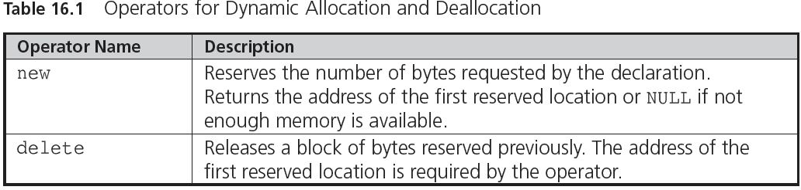
Dynamic Structure Allocation (cont'd.)
CSC 1100 – Wk11
A First Book of C++ 4th Edition

Slide 21
Dynamic Structure Allocation (cont'd.)
CSC 1100 – Wk11
Dynamically requesting storage for a structure
If structure has been declared as follows:
struct TeleType
{
string name;
string phoneNo;
};
Expressions new(TeleType) or new TeleType reserve storage for one TeleType structure
Program 16.7 illustrates use of new to dynamically create a structure in response to user input request
A First Book of C++ 4th Edition

Slide 22
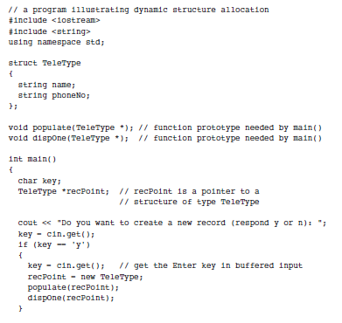
Dynamic Structure Example (Program 16.7)
CSC 1100 – Wk11
A First Book of C++ 4th Edition

Slide 23
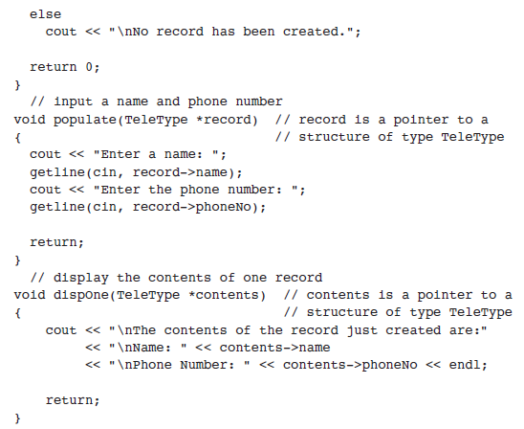
Dynamic Structure Example (cont)
CSC 1100 – Wk11
getting continouos string/text from keyboard without space
A First Book of C++ 4th Edition

Slide 24
Dynamic Structure Allocation (cont'd.)
CSC 1100 – Wk11
Example: Program 16.7 (refer textbook Pg 722-723)
Two variables declared in main()
key declared as a character variable
recPoint declared as pointer to structure of the TeleType type
If user enters y in response to first prompt in main(), a call to new is made for memory to store structure
Address loaded into recPoint can be used to access newly created structure
A First Book of C++ 4th Edition

Slide 25
Dynamic Structure Allocation (cont'd.)
CSC 1100 – Wk11
Example: Program 16.7 (cont’d.)
The function populate() prompts user for data to fill structure
The argument passed to populate() in main() is pointer recPoint
The dispOne() function displays contents of newly created and populated structure
Address passed to dispOne() is same address that was passed to populate()
A First Book of C++ 4th Edition

Slide 26
Unions
CSC 1100 – Wk11
Union
Data type that reserves the same area in memory for two or more variables that can be different data types
Definition of a union has the same form as a structure definition
union
{
char key;
int num;
double price;
} val;
A First Book of C++ 4th Edition

Slide 27
Unions (cont'd.)
CSC 1100 – Wk11
A union reserves enough memory locations to accommodate its largest member’s data type
Same set of locations is then referenced by different variable names
Each value stored overwrites the previous value
Union members are referenced by using the same notation as structure members
A data type can be associated with a union
Unions can be members of structures or arrays, and structures, arrays, and pointers can be members of unions
A First Book of C++ 4th Edition

Slide 28
Union Example 1 (Memory Allocation)
CSC 1100 – Wk11
#include <iostream>
using namespace std;
union Student1 { //defining a union
char name[32];
float cgpa;
int matric_no;
};
struct Student2 {
char name[32];
float cgpa;
int matric_no;
};
int main(){
Student1 stud1;
Student2 stud2;
cout << "Size of union = " << sizeof(stud1);
cout << "Size of structure = " << sizeof(stud1) << endl;
system("pause");
return 0;
}
name
32 bytes
name
cgpa
matric_no
+
+
32 bytes
4 bytes
4 bytes
C++ for Everyone

Slide 29
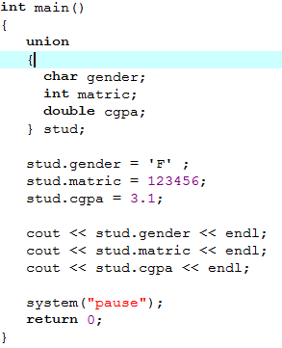

Union Example 2
CSC 1100 – Wk11
Output:
Only the last member value stud.cgpa
is displayed because it is the most recently available in the memory location assigned to union members.
A First Book of C++ 4th Edition

Slide 30
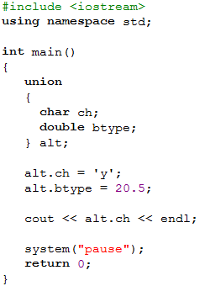

Union Example 3
CSC 1100 – Wk11
Output:
The program displays nothing because
the memory space for ch has been
occupied by btype and thus overwritten.
Now the value of btype is occupying
the same memory space.
A First Book of C++ 4th Edition

Slide 31
Unions as a member (nested in structure)
CSC 1100 – Wk11
struct
{
char uType; // member of the struct val
union // declaring a union within a struct
{
char *text;
float rate;
} uTax; //name of union
} flag; // name of variable
The variable rate can be referenced as flag.uTax.rate
A First Book of C++ 4th Edition

Slide 32
Common Programming Errors
CSC 1100 – Wk11
Trying to use a structure, as a complete entity, in a relational expression
Individual members of structure can be compared, but not entire structure
Using pointer in relation to structure and not indicating proper data type
Because a union can store only one of its members at a time, you must be careful to keep track of the currently stored variable
A First Book of C++ 4th Edition

Slide 33
Summary
CSC 1100 – Wk11
A structure allows individual variables to be grouped under common variable name
A data type can be created from structure by using declaration form
struct Data-type
{
individual member declarations;
};
Individual structure variables may then be defined as this data type
A First Book of C++ 4th Edition

Slide 34
Summary (cont'd.)
CSC 1100 – Wk11
Structures are useful as elements of arrays
Complete structures can be function arguments
Called function receives copy of each element in structure
The address of structure may also be passed, either as reference or as pointer
Structure members can be any C++ data type, including other structures, arrays, and pointers
Unions are declared in the same manner as structures
A First Book of C++ 4th Edition

